Slide 1
Operations Management
William J. Stevenson
8th edition

Slide 2
CHAPTER
3
Forecasting
Operations Management, Eighth Edition, by William J. Stevenson
Copyright © 2005 by The McGraw-Hill Companies, Inc. All rights reserved.
McGraw-Hill/Irwin

Slide 3
FORECAST:
A statement about the future value of a variable of interest such as demand.
Forecasts affect decisions and activities throughout an organization
  Accounting, finance
  Human resources
  Marketing
  MIS
  Operations
  Product / service design

Slide 4
Uses of Forecasts
Accounting | Cost/profit estimates
Finance | Cash flow and funding
Human Resources | Hiring/recruiting/training
Marketing | Pricing, promotion, strategy
MIS | IT/IS systems, services
Operations | Schedules, MRP, workloads
Product/service design | New products and services

Slide 5
Elements of a Good Forecast
Timely
Reliable
Accurate
Meaningful
Written
Easy to use

Slide 6
Characteristics of forecasting
Forecasting techniques generally assumes that the same underlying causal system that existed in the past will continue to exist in the future.
Forecasts are rarely perfect.
Forecasts for the groups tend to be more perfect.
Forecast accuracy decreases as the time period covered by the forecast increases.

Slide 7

Steps in the Forecasting Process
“The forecast”
Step 6 Monitor the forecast
Step 5 Prepare the forecast
Step 4 Gather and analyze data
Step 3 Select a forecasting technique
Step 2 Establish a time horizon
Step 1 Determine purpose of forecast

Slide 8
Types of Forecasts
Judgmental /Qualitative- uses subjective inputs
Quantitative
Time series - uses historical data assuming the future will be like the past
Associative models - uses explanatory variables to predict the future

Slide 9
Judgmental Forecasts
Executive opinions
Sales force opinions
Consumer surveys
Outside opinion
Delphi method
  Opinions of managers and staff
  Achieves a consensus forecast

Slide 10
The Delphi method is a process used to arrive at a group opinion or decision by surveying a panel of experts.
Experts respond to several rounds of questionnaires, and the responses are aggregated and shared with the group after each round.
The experts can adjust their answer each round, based on how they interpret the "group response" provided to them.
The ultimate result is meant to be a true consensus of what the group thinks.
Several rounds of questionnaires are sent out to the group of experts, and the anonymous responses are aggregated and shared with the group after each round. The experts are allowed to adjust their answers in subsequent rounds, based on how they interpret the "group response" that has been provided to them. Since multiple rounds of questions are asked and the panel is told what the group thinks as a whole, the Delphi method seeks to reach the correct response through consensus

Slide 11
Time Series Forecasts
Trend - long-term movement in data
Seasonality - short-term regular variations in data
Cycle – wavelike variations of more than one year’s duration
Irregular variations - caused by unusual circumstances
Random variations - caused by chance
A seasonal pattern exists when a series is influenced by seasonal factors (e.g., the quarter of the year, the month, or day of the week). Seasonality is always of a fixed and known period. ... A cyclic pattern exists when data exhibit rises and falls that are not of fixed period.
WHAT ARE SEASONAL EFFECTS? A seasonal effect is a systematic and calendar related effect. Some examples include the sharp escalation in most Retail series which occurs around December in response to the Christmas period, or an increase in water consumption in summer due to warmer weather.

Slide 12
Forecast Variations
Figure 3.1
Irregular
variation
Trend
Cycles
90
89
88
Seasonal variations

Slide 13

Naive Forecasts
Uh, give me a minute....
We sold 250 wheels last
week.... Now, next week we should sell....
The forecast for any period equals the previous period’s actual value.

Slide 14
Naïve Forecasts
Simple to use
Virtually no cost
Quick and easy to prepare
Data analysis is nonexistent
Easily understandable
Cannot provide high accuracy
Can be a standard for accuracy

Slide 15
Uses for Naïve Forecasts
Stable time series data
  F(t) = A(t-1)
Seasonal variations
  F(t) = A(t-n)
Data with trends
  F(t) = A(t-1) + (A(t-1) – A(t-2))

Slide 16
Techniques for Averaging
Moving average
Weighted moving average
Exponential smoothing

Slide 17
Moving Averages
Moving average – A technique that averages a number of recent actual values, updated as new values become available.
Weighted moving average – More recent values in a series are given more weight in computing the forecast.
n
∑
A_{i}
MA_{n}
=
i = 1
n

Slide 18
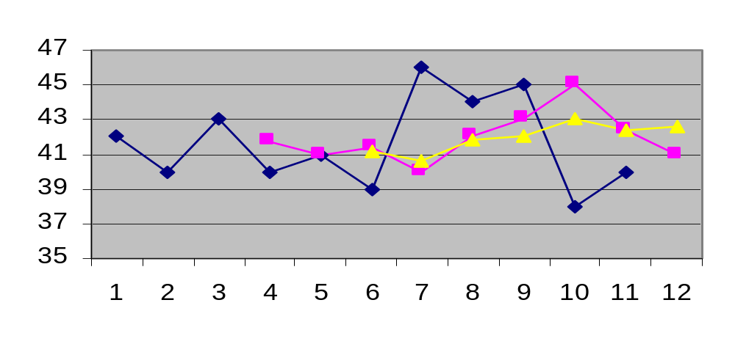
Simple Moving Average
Actual
MA5
MA3
n
∑
A_{i}
MA_{n}
=
i = 1
n

Slide 19
Exponential Smoothing
F_{t} = F_{t-1} + α(A_{t-1} - F_{t-1})
Premise--The most recent observations might have the highest predictive value.
  Therefore, we should give more weight to the more recent time periods when forecasting.

Slide 20
Exponential Smoothing
F_{t} = F_{t-1} + α(A_{t-1} - F_{t-1})
Weighted averaging method based on previous forecast plus a percentage of the forecast error
A-F is the error term, α is the % feedback

Slide 21
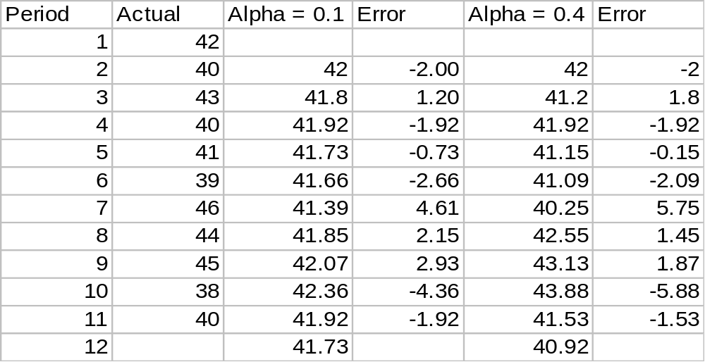
Example 3 - Exponential Smoothing

Slide 22
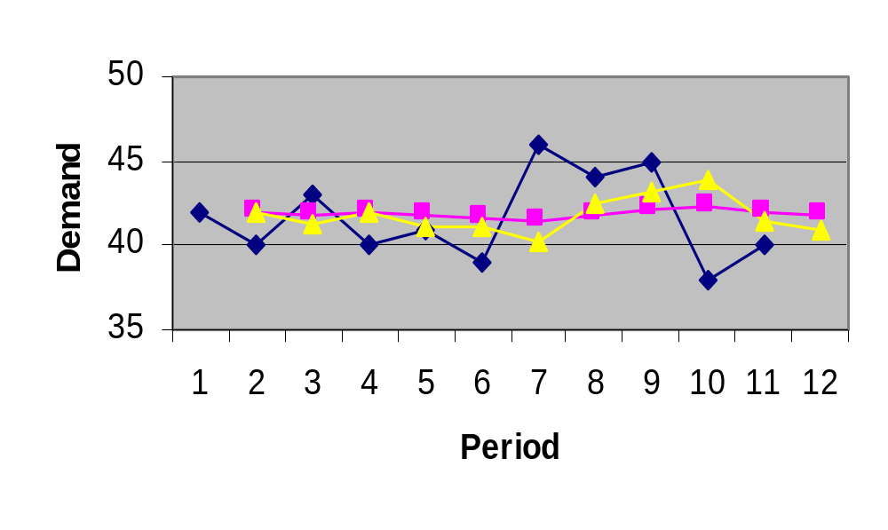
Picking a Smoothing Constant
Actual
α = .4
α = .1

Slide 23
Common Nonlinear Trends
Figure 3.5
Parabolic
Exponential
Growth

Slide 24
Linear Trend Equation
F_{t}
F_{t} = a + bt
F_{t} = Forecast for period t
t = Specified number of time periods
a = Value of F_{t} at t = 0
b = Slope of the line
0 1 2 3 4 5 t

Slide 25
Calculating a and b
n
∑
(ty)
-
∑
t
y
∑
b
=
2
2
n
t
-
(
t)
∑
∑
∑
y
-
b
∑
t
a
=
n

Slide 26
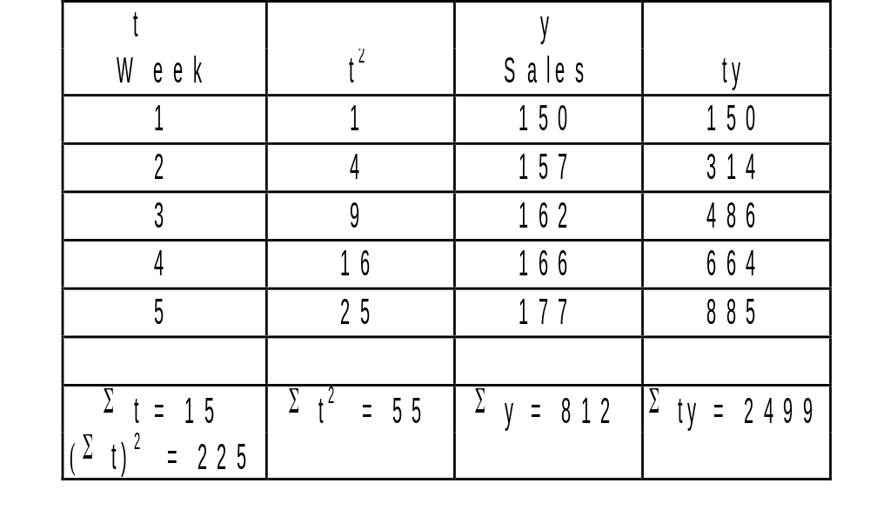
Linear Trend Equation Example

Slide 27
Linear Trend Calculation
5 (2499)
-
15(812)
12495
-
12180
b
=
=
=
6.3
5(55)
-
225
275
-
225
812
-
6.3(15)
a
=
=
143.5
5
y = 143.5 + 6.3t

Slide 28
Associative Forecasting
Predictor variables - used to predict values of variable interest
Regression - technique for fitting a line to a set of points
Least squares line - minimizes sum of squared deviations around the line

Slide 29
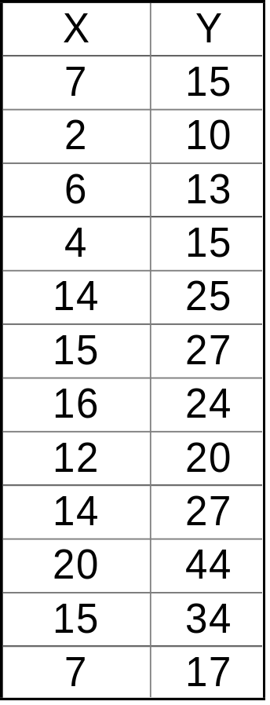
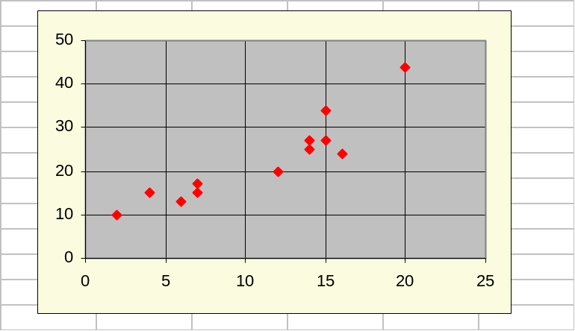
Linear Model Seems Reasonable
Computed
relationship
A straight line is fitted to a set of sample points.

Slide 30
Forecast Accuracy
Error - difference between actual value and predicted value
Mean Absolute Deviation (MAD)
  Average absolute error
Mean Squared Error (MSE)
  Average of squared error
Mean Absolute Percent Error (MAPE)
  Average absolute percent error

Slide 31
MAD, MSE, and MAPE
∑
Actual
−
forecast
MAD
=
n
(
Actual
−
forecast)
2
∑
MSE
=
n
-
1
∑(
Actual
−
forecast
/ Actual*100)
MAPE
=
n

Slide 32
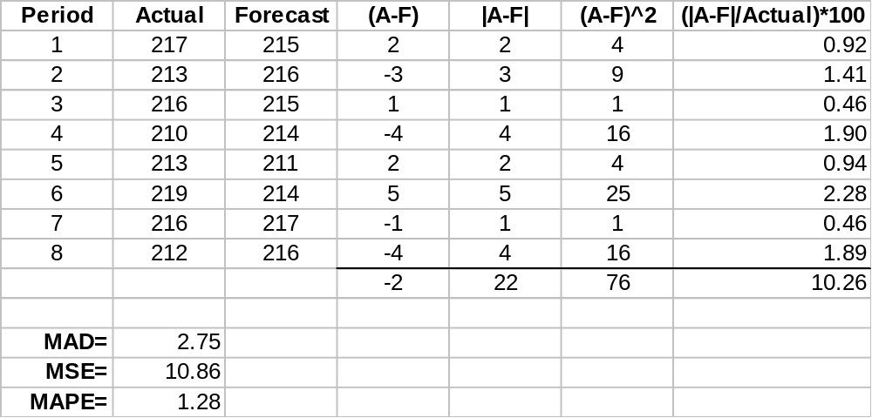
Example 10

Slide 33
Controlling the Forecast
Control chart
  A visual tool for monitoring forecast errors
  Used to detect non-randomness in errors
Forecasting errors are in control if
  All errors are within the control limits
  No patterns, such as trends or cycles, are present

Slide 34
Sources of Forecast errors
Model may be inadequate
Irregular variations
Incorrect use of forecasting technique

Slide 35
Tracking Signal
Tracking signal
  Ratio of cumulative error to MAD
∑
(Actual
-
forecast)
Tracking signal
=
MAD
Bias – Persistent tendency for forecasts to be
Greater or less than actual values.

Slide 36
Choosing a Forecasting Technique
No single technique works in every situation
Two most important factors
  Cost
  Accuracy
Other factors include the availability of:
  Historical data
  Computers
  Time needed to gather and analyze the data
  Forecast horizon

Slide 37
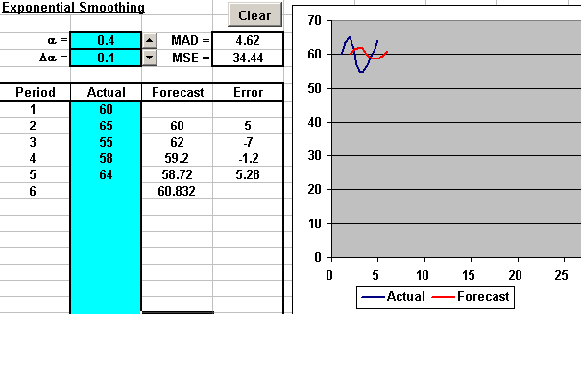
Exponential Smoothing

Slide 38
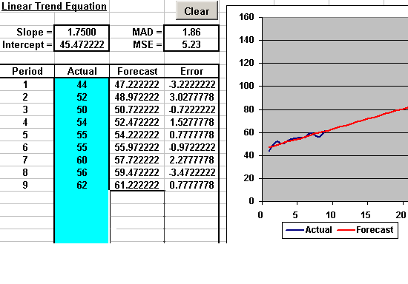
Linear Trend Equation

Slide 39
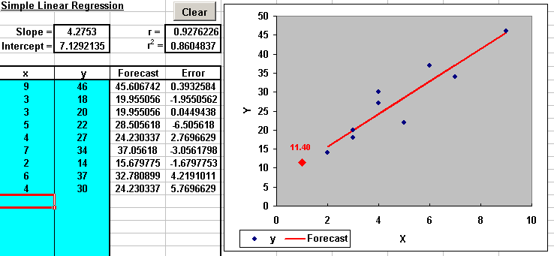
Simple Linear Regression

